Slide 1
Sentimental of Analysis of Text
TEAM MEMBERS
LOGESH KUMAR M – 727722EUIT096
PRANAV A – 727722EUIT131
NITHISH KUMAR P – 727722EUIT123
GUIDED BY
Dr. G. EDWIN PREM KUMAR, M.E.,Ph. D
PROFESSOR,
DEPARTMENT OF INFORMATION TECHNOLOGY

Slide 2
Introduction
What is Sentiment Analysis?
Sentiment analysis is a method used to extract emotions or opinions expressed in text.
It helps in understanding customer sentiment in reviews, feedback, social media posts, etc.
Why Use Naive Bayes for Sentiment Analysis?
Naive Bayes is a simple, yet powerful algorithm based on probability, widely used for text classification tasks.
Efficient in handling large datasets.

Slide 3
Abstract
Objective: To build a sentiment analysis system that classifies text into positive, negative, or neutral sentiments using the Naive Bayes algorithm and explore advanced approaches using BERT (Bidirectional Encoder Representations from Transformers) for enhanced context understanding.
Method:
Preprocessing text (tokenization, stopword removal).
Extracting features (Bag of Words or TF-IDF for Naive Bayes).
Training a Naive Bayes model on labeled data.
Utilizing BERT to capture deeper, bidirectional context for better sentiment prediction, especially in cases involving complex language such as sarcasm or ambiguous statements.
Expected Outcome:
A Naive Bayes classifier capable of efficiently predicting sentiment from text.
Enhanced accuracy and context understanding with BERT, particularly in nuanced scenarios where traditional models might misinterpret the sentiment.

Slide 4
Existing system
Current Sentiment Analysis Solutions:
Lexicon-based models (e.g., VADER).
Machine learning models like Support Vector Machines (SVM), decision trees, and deep learning models.
Challenges:
Complexity in training for large datasets.
High computational requirements for advanced models.
Poor handling of sarcasm, context, and mixed sentiments.

Slide 5
Disadvantages
Sarcasm and Context Misinterpretation: Difficulty in identifying sarcastic or ironic statements.
Ambiguity: Mixed sentiments in one sentence are not handled well.
Domain-Specific Challenges: General models do not perform well in specific domains like healthcare or finance.
Handling of Slang and Negations: Difficulty in processing informal language and negation.
Imbalanced Datasets: Skewed distribution of positive, negative, and neutral classes in datasets.

Slide 6
Literature Survey
Naive Bayes for Sentiment Analysis: Studies show Naive Bayes works efficiently for text classification.
Comparison of Naive Bayes with Other Algorithms: Naive Bayes outperforms SVM in terms of efficiency and simplicity but struggles with deep contextual understanding.
Use of Transformer Models in Sentiment Analysis: Research indicates models like BERT can handle complex context and sarcasm but are resource-heavy.

Slide 7
Proposed System
System Overview:
Step 1: Text Preprocessing (Tokenization, Stopword Removal, Stemming/Lemmatization).
Step 2: Feature Extraction (Bag of Words, TF-IDF).
Step 3: Naive Bayes Model Training on labeled data.
Step 4: Sentiment Classification (Positive, Negative, Neutral).
Architecture:
Input Data → Preprocessing → Feature Extraction → Naive Bayes Classifier → Sentiment Prediction.

Slide 8
Bayes' Theorem
P(c∣x)=P(x∣c)⋅P(c)​/P(x)
Where:
P(c∣x)is the posterior probability that the class label ccc (e.g., positive or negative sentiment) is true given the input data xxx (i.e., the text).
P(x∣c) is the likelihood of the data xxx given the class ccc.
P(c) is the prior probability of the class ccc.
P(x) is the marginal likelihood, or the probability of the data xxx, which acts as a normalizing factor.

Slide 9
Disadvantages of Naive Bayes and How to Overcome Them
Sarcasm and Context Misinterpretation:
Naive Bayes fails to detect sarcasm because it does not account for complex sentence structures.
How to Overcome:
Use Advanced NLP Models: Leverage transformers like BERT to handle complex contexts and sarcasm better.
Sarcasm Detection: Train a sarcasm detection model to recognize sarcasm before sentiment classification.
Include Contextual Features: Use cues such as emoticons, punctuation, or metadata like past user behavior to understand sarcasm.
Use of Specialized Datasets: Train on datasets labeled with sarcasm and irony.

Slide 10
Advantages of Naive Bayes
Efficiency:
Naive Bayes is computationally light and can handle large datasets with low training time.
Simplicity:
Easy to implement with fewer computational resources compared to deep learning models.
Strong Performance in Text-Based Applications:
Performs well on straightforward text classification tasks.
Interpretability:
Provides a probabilistic output that is easy to interpret and explain.

Slide 11
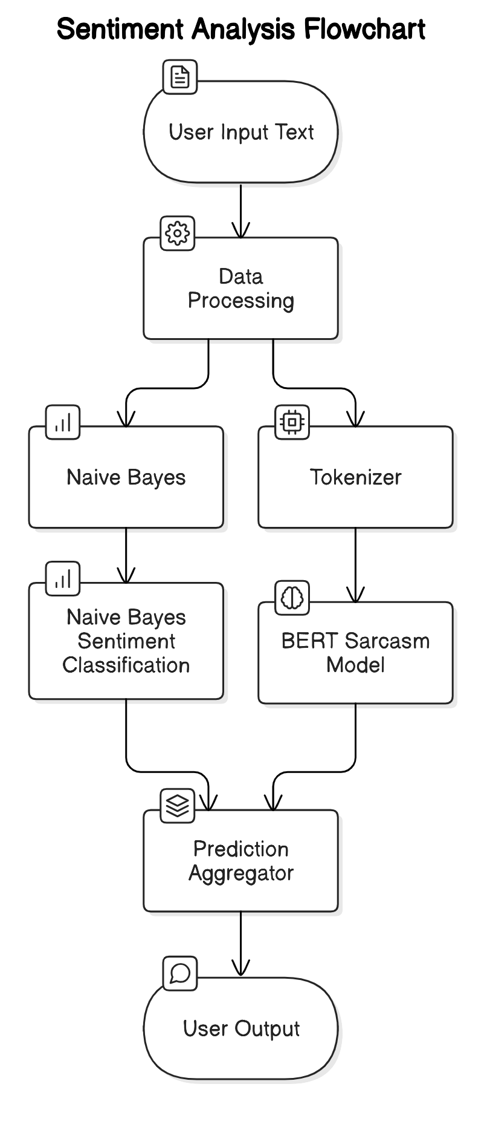
ARCHITECTURAL DIAGRAM
This sentiment analysis system combines Naive Bayes and BERT models to improve sentiment accuracy, especially in detecting sarcasm. Text input undergoes preprocessing: Naive Bayes uses TF-IDF vectorization for basic sentiment prediction, while BERT tokenizes the text for context-aware sarcasm detection. The predictions are combined, with BERT’s sarcasm detection taking priority if the two models disagree, ensuring a more accurate interpretation of complex expressions. This architecture balances Naive Bayes' efficiency with BERT’s nuanced understanding, delivering reliable positive, negative, or neutral sentiment outputs.

Slide 12
MODULES
Data Loading and Preprocessing Module
Naive Bayes Sentiment Analysis Module
BERT-based Sarcasm Detection Module
Prediction Combination Module
User Interface Module

Slide 13
1. Data Loading and Preprocessing Module
This module is responsible for loading the Sentiment140 dataset and preparing it for training. It reads the CSV file containing tweet text and sentiment polarity, maps polarity values (0 for negative, 2 for neutral, 4 for positive), and cleans the text by removing unwanted characters and formatting it to lowercase. The text is then vectorized using TF-IDF, converting it into numerical vectors that can be used by the Naive Bayes classifier. This initial preparation ensures the data is ready for effective model training and analysis.

Slide 14
2. Naive Bayes Sentiment Analysis Module
This module uses a Naive Bayes classifier to analyze sentiment based on the TF-IDF features from the dataset. It trains the Naive Bayes model on these vectors, allowing it to predict sentiment categories (positive, negative, or neutral) with associated confidence scores. The module incorporates a threshold mechanism, where predictions are only classified if the confidence level meets a certain threshold, ensuring reliable sentiment categorization.

Slide 15
3. BERT-based Sarcasm Detection Module
This module enhances sentiment analysis by detecting sarcasm, using a BERT model fine-tuned to classify text as sarcastic or non-sarcastic. Input text is tokenized and passed through the BERT model, which outputs a binary label (1 for sarcasm, 0 for non-sarcasm). This detection helps refine sentiment analysis by accounting for sarcastic expressions that may otherwise skew the primary sentiment prediction.

Slide 16
4. Prediction Combination Module
This module integrates predictions from both the Naive Bayes and BERT models to produce a final sentiment classification. It applies logic to prioritize predictions based on text length and complexity, often giving more weight to sarcasm detection for longer or complex texts. When predictions from both models conflict, this module intelligently combines them to reflect sarcasm or sentiment with greater accuracy, yielding a more nuanced sentiment prediction.

Slide 17
5. User Interface Module
This module provides an interactive command-line interface, allowing users to input sentences for analysis and view sentiment predictions in real-time. It accepts text input, processes it through the combined sentiment pipeline, and displays the sentiment as positive, neutral, or negative based on the analysis. It also manages user exit requests, offering a smooth and user-friendly way to interact with the sentiment analysis system.

Slide 18
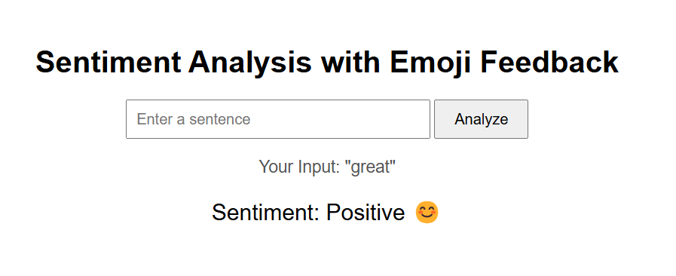

Slide 19
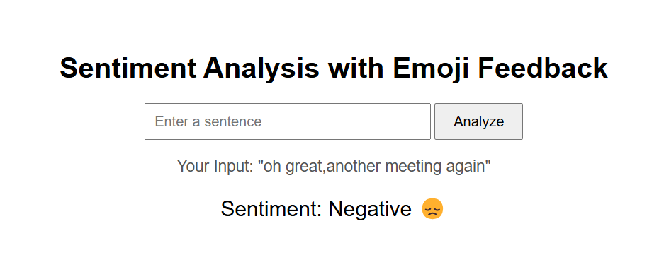

Slide 20
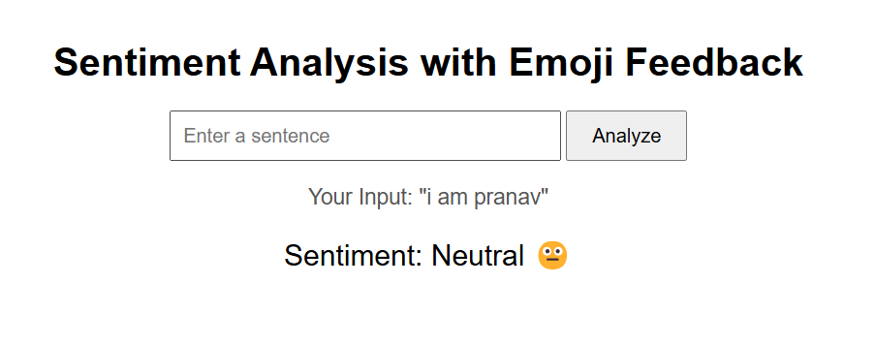

Slide 21
References
[1] Cambria, E., & White, B. (2014). Jumping NLP Curves: A Review of Natural Language Processing Research. IEEE Computational Intelligence Magazine, 9(2), 48-57.
[2] Liu, B. (2012). Sentiment Analysis and Opinion Mining. Synthesis Lectures on Human Language Technologies, 5(1), 1-167
[3] Zhang, L., Wang, S., & Liu, B. (2018). Deep Learning for Sentiment Analysis: A Survey. Wiley Interdisciplinary Reviews: Data Mining and Knowledge Discovery, 8(4), e1253.
[4] Nadkarni, P., Ohno-Machado, L., & Chapman, W. W. (2011). Natural Language Processing: An Introduction. Journal of the American Medical Informatics Association, 18(5), 544-551.

Slide 22


